Slide 1
Compressed Sensing: A lightweight randomized compression technique with sampling rate much lower than the Nyquist rate for analog signals, verified by GI in comparison with CR and IT reconstruction schemes
Title
Being carried out at Indian Institute of Science
External Guide Internal Guide
Dr. Bhakthavathsalam.R Savitha.G
Senior Scientific Officer Associate Professor
Dept of SERC Dept of CS&E
Indian Institute of Science BNMIT
Bangalore Bangalore
Team Members:
Abhishek Sharma.R 1BG10CS003
Chaitra Suresh 1BG10CS025
Chandan S 1BG10CS026

Slide 2
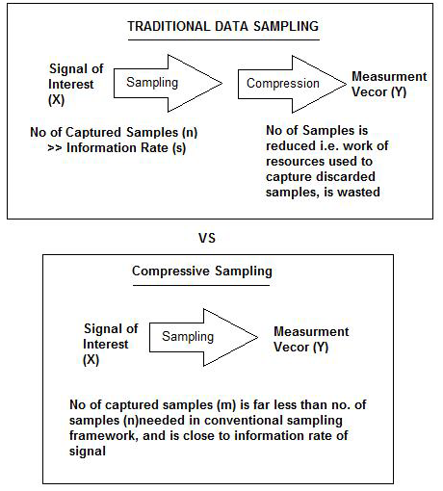
Introduction
The entire signal can be determined accurately from relatively few measurements.
Compressed sensing challenges the traditional sample first-then compress procedure.

Slide 3
Problem statement
To sample a given analog signal at a rate much lower than the Nyquist rate suggested by the Nyquist-Shannon sampling theorem and reconstruct the original signal using Convex Relaxation(CR), Greedy Iterative(GI) and Iterative Thresholding(IT) reconstruction schemes.

Slide 4
System Design
User
Signal
Sampling
Samples
Reconstructed signal
Reconstruction

Slide 5
System Architecture
Sampling
Input Signal
Reconstruction
Basis Pursuit
AMP
OMP
Reconstructed
Signal

Slide 6
Implementation Requirements
Software Requirements
Windows 7/8/8.1
Matlab 2013a
Hardware Requirements
1 Ghz Processor
1GB RAM
16 GB hard disk space

Slide 7
Implementation Modules
Sampling
Input: Signal to be sampled ‘f’
Basis matrix(Ψ) is applied to the input signal.
The vector ‘c’ consisting of major frequency components of the signal is obtained
Sampling matrix(Φ) is applied to vector c, Random Samples ‘b’ are obtained.
Output: Frequency samples of the input signal ‘b’
Reconstruction
Input: Samples of the input signal ‘b’
Express the problem to be solved in the form ‘Ax=b’ where A= Φ Ψ and ‘x’ is the solution to be found. Express this as an optimization problem.
Solve the problem using any of the following algorithms:
Basis Pursuit
Approximate Message Passing
Orthogonal Matching Pursuit
Output: Reconstructed signal

Slide 8
Testing
Sampling Module:
Valid key entered?
Is the number of samples taken the same for all inputs?
Is the data being written into a file?
Is this file sent successfully?
Reconstruction Module:
Is the file received successfully?
Are the contents of the file read properly?
Is the reconstruction successful?

Slide 9
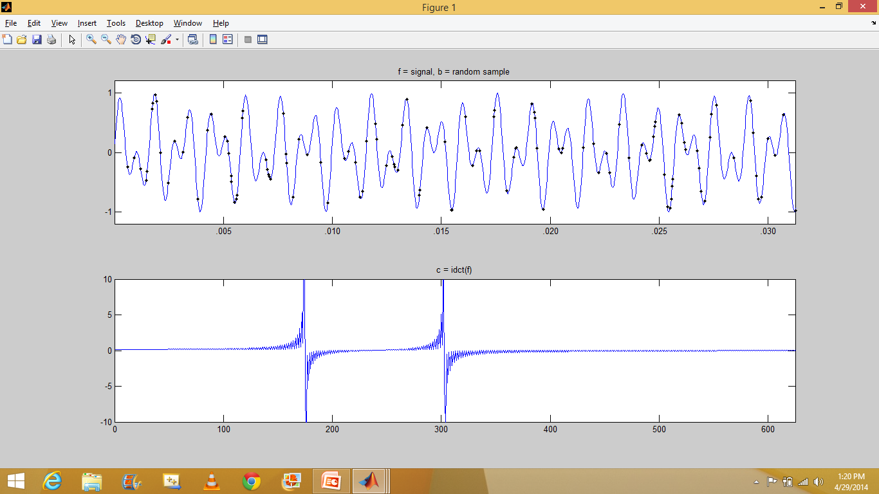
Result
Original signal

Slide 10
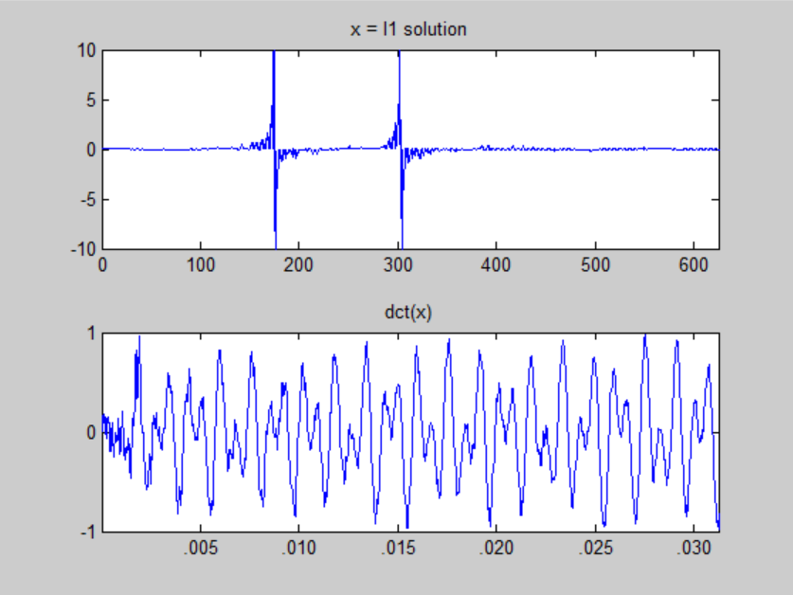
Basis Pursuit Solution

Slide 11
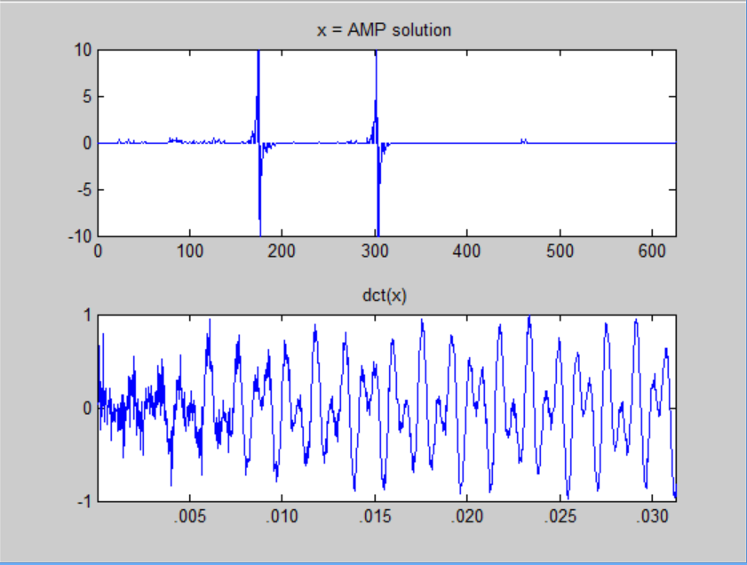
AMP Solution

Slide 12
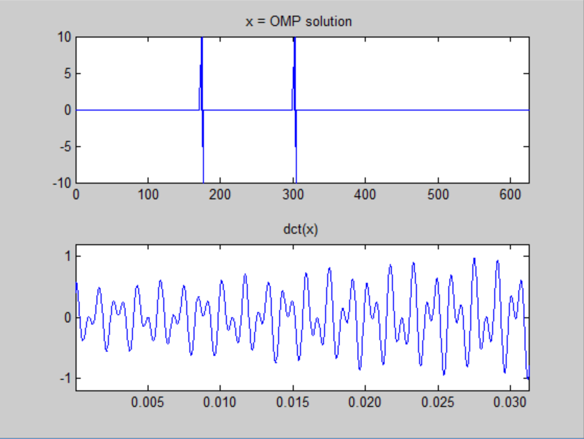
OMP Solution

Slide 13

Conclusion
An analog signal was generated ,Sampling was done by employing the compressive sampling method and the signal was reconstructed using the following three techniques:
1)Basis Pursuit
2)Orthogonal Matching Pursuit
3)Approximate Message Passing
A comparison was done between the three abovementioned algorithms in terms of the following 2 parameters:
1)Time taken to reconstruct the signal :
It was found that OMP takes approximately 10 seconds, AMP takes approximately 15 seconds, Basis Pursuit takes approximately 70 seconds for the given inputs.
2) Error :
The values of error rates for the three schemes are calculated as

Slide 14
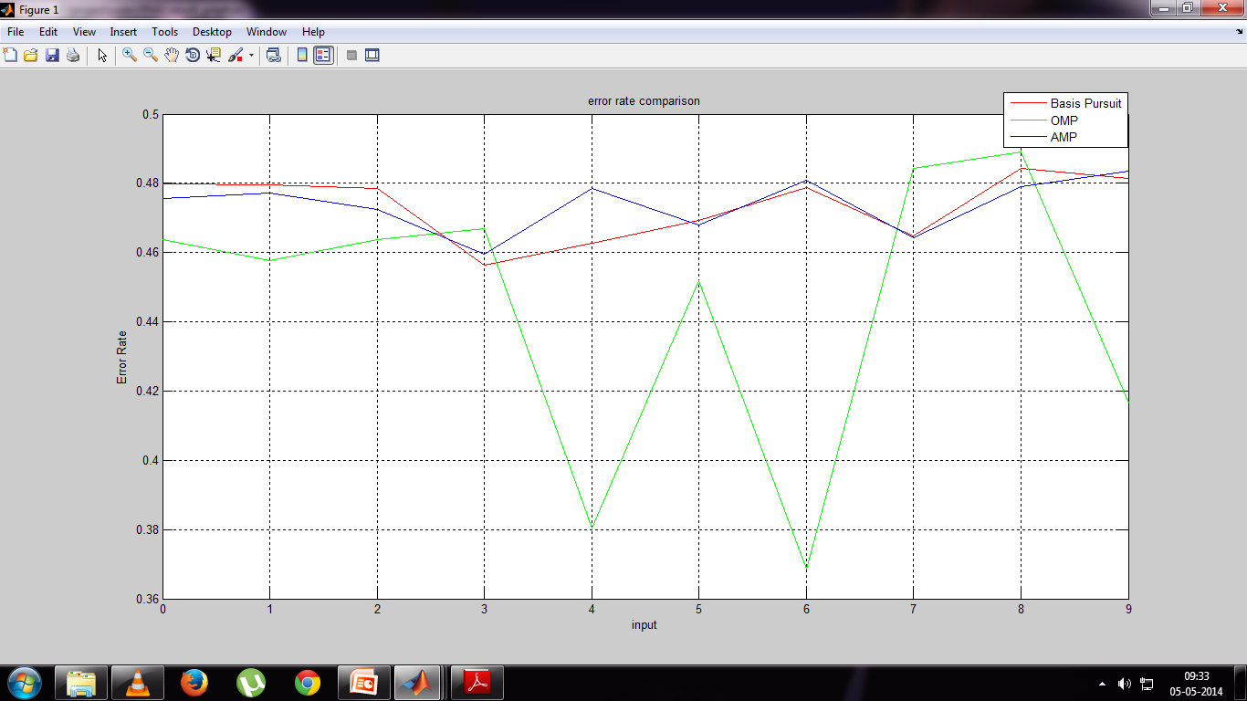
Average error rate for
Basis Pursuit is 0.4736
Orthogonal Matching Pursuit is 0.4443
Approximate Message Passing is 0.4739

Slide 15
References
Saad Qaisar, Wafa Iqbal,Rana Muhammad Bilal, Muqaddas Naureen, Sungyoung Lee, "Compressive Sensing: From Theory to Applications, A Survey", Journal of Communications and Networks, October 2013.
2. D. Donoho, “Compressed sensing,” IEEE Trans. Inform. Theory, April 2006.
3. E. CandÃ¨s , J. Romberg and T. Tao "Robust uncertainty principles: Exact signal reconstruction from highly incomplete frequency information", IEEE Trans. Inform. Theory, 2006.
4. An Introduction To Compressive Sampling Candes, E.J. Wakin, M.B. Signal Processing Magazine, IEEE,2008.
5. Compressed Sensing Reconstruction via Belief Propagation Shriram Sarvotham, Dror Baron and Richard G. Baraniuk Department of Electrical and Computer Engineering Rice University, Houston, TX 77005, USA,July 14, 2006

Slide 16
6. ’Algorithms for Sparse Approximation’,Philip Breen
7. ‘Iterative Thresholding for Sparse Approximations’,Thomas Blumensath and Mike E. Davies, The Journal of Fourier Analysis and Applications
8. ‘Message-passing algorithms for compressed sensing’,David L. Donoho, Arian Maleki, and Andrea Montanaria, Departments of Statistics and Electrical Engineering, Stanford University, September 11, 2009
9. ‘Message Passing Algorithms for Compressed Sensing: I. Motivation and Construction ‘, David L. Donoho, Arian Maleki, and Andrea Montanaria, Departments of Statistics and Electrical Engineering, Stanford University

